Slide 1


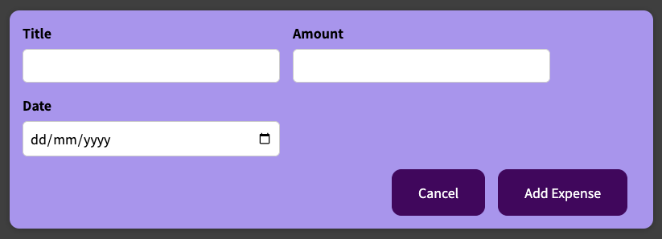
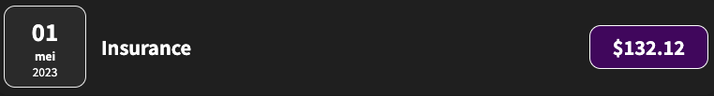
App
Component
Data / State
Handler
Add
Render
expenses[]
Read
addExpenseHandler
Read
Render
onAddExpense={addExpenseHandler}
items={expenses}
NewExpense
Expenses
items
(enteredExpense)
write
isEditing
saveExpensesHandler
filteredYear
filterChangeHandler
true
Read
false
startEditingHandler
Trigger
stopEditingHandler
Render
filteredExpenses
Render
! isEdting
isEdting
selected={filteredYear}
onChangeFilter={filterChangeHandler}
(selectedYear)
items={filteredExpenses}
onClick={startEditingHandler}
onSaveExpenseData={saveExpensesHandler}
onCancel={stopEditingHandler}
ExpensesList
[Add New Expense]
ExpensesFilter
ExpenseForm
items
dropdownChangeHandler
Render
(items.map (item))
onClick
Entered
Data
submitHandler
Expense
Data
onChangeFilter
Read
Read
Key={item.id}
Item={item}
Render
ExpenseItem
date={item.date}
ExpenseDate

Slide 2
App
Component
Data / State
Handler
Add
Render
expenses[]
Read
addExpenseHandler
Read
Render
items={expenses}
Expenses
items
write
filteredYear
Read
filterChangeHandler
filteredExpenses
Render
selected={filteredYear}
onChangeFilter={filterChangeHandler}
(selectedYear)
items={filteredExpenses}
items={filteredExpenses}
ExpensesList
ExpensesChart
ExpensesFilter
items
chartDataPoints
dropdownChangeHandler
Render
(items.map (item))
Render
(items.map (item))
onChangeFilter
Key={item.id}
Item={item}
dataPoints={chartDataPoints}
ExpenseItem
Chart
date={item.date}
Value, MaxValue, Label
ExpenseDate
ChartBar

Slide 3
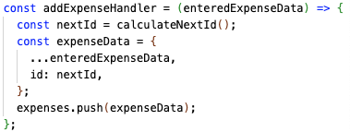
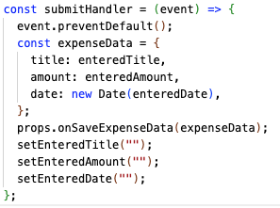

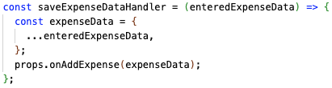


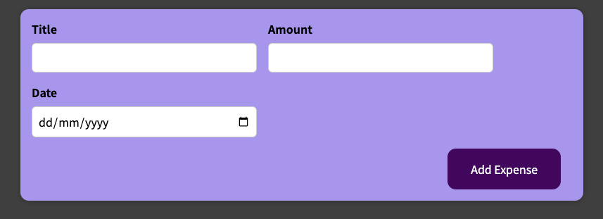
App
NewExpense
ExpenseForm

